Slide 1
Why we do what we do
Web Solutions
Software Solutions
Digital Marketing

Slide 2
An Idea can change your mind
Web Solutions | Software Solutions | Digital Marketing

Slide 3
We can deliver solutions
awesome
Visionary
Convincing
Ambitious
Web Solutions | Software Solutions | Digital Marketing

Slide 4
“A brand is more than a promise, it’s a commitment to create a unique experience beyond expectation each time, every time for your customers.”
A commitment to deliver. (Quality)
Web Solutions | Software Solutions | Digital Marketing

Slide 5
With a vendor available at every corner, customers are seeking something different.
Standing a class apart
Web Solutions | Software Solutions | Digital Marketing

Slide 6
The Challenge
Web Solutions | Software Solutions | Digital Marketing

Slide 7
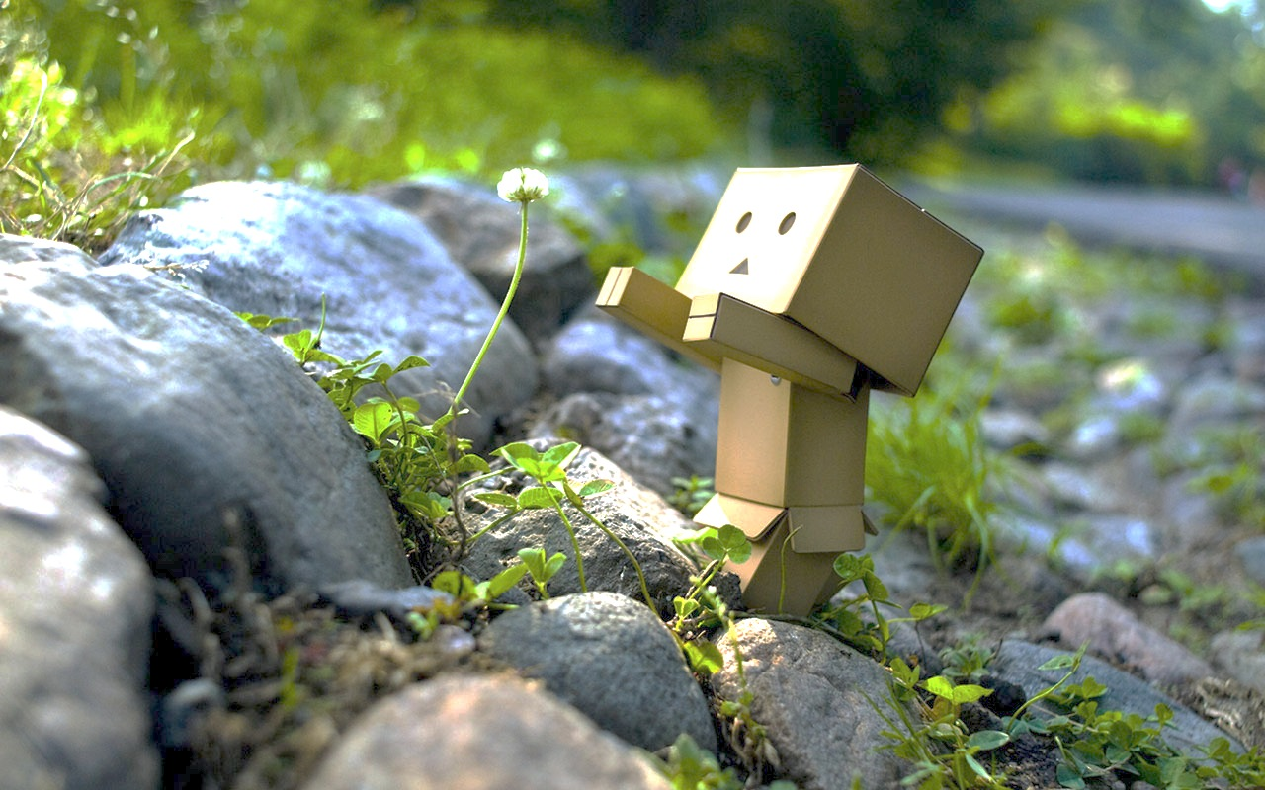
“Its no longer just the Product, Price, Place or Promotion “
Be the change…
Its more about Customer, Convenience, Communication and Cost
Web Solutions | Software Solutions | Digital Marketing

Slide 8
“Because customers are now more informed, want to be more connected with, share their interests more openly and want to feel special or unique”
And why?
Web Solutions | Software Solutions | Digital Marketing

Slide 9
What does it take to create that unique experience?
Web Solutions | Software Solutions | Digital Marketing

Slide 10
A tailor made experience?
Web Solutions | Software Solutions | Digital Marketing

Slide 11
We call it Experience Modeling.
Web Solutions | Software Solutions | Digital Marketing

Slide 12
Experience change
for lasting impressions
Web Solutions
Software Solutions
Digital Marketing

Slide 13
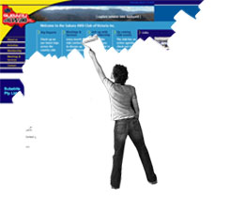
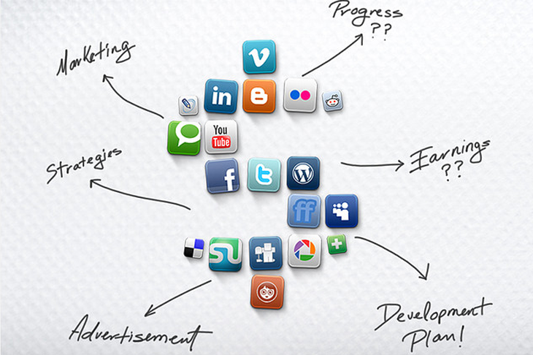
Welcome to Arete
Redesign
Or
Develop
your site
Or even Create
Customized Software Applications
Boost
your rank
Manage
your reputation
Promote
your company
Analyze
your competitors
Rework
on your content
Research
your market

Slide 14
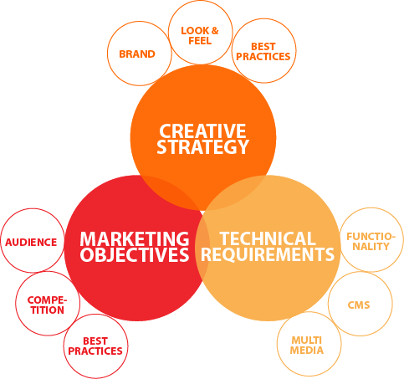
A 3 Fold APPROACH

Slide 15
We practice SOCIAL MEDIA for ourselves too…..

Slide 16
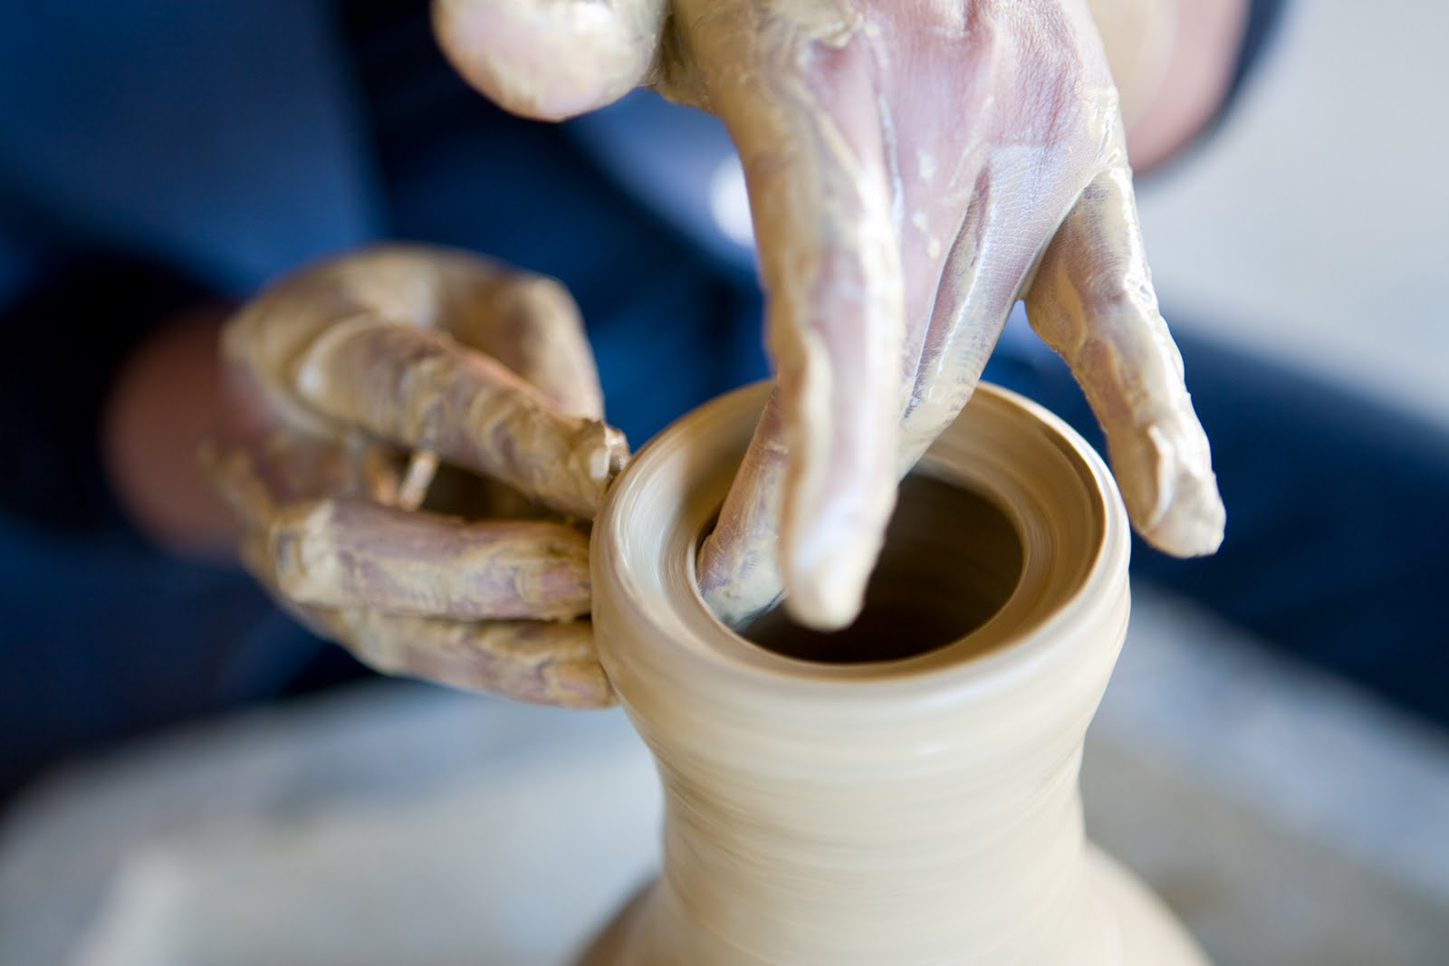
WHY ARETE
For much of human history, we have
Been on a quest for perfection + control

Slide 17
WHY ARETE
Journey of a thousand miles begins with a single step
Hours worked
Since 2005
Lines of
code
Clients
served
Projects
Completed
Years
Of
Experience
We created processes, enabling us to create our own technology libraries, for enhanced production

Slide 18
WHY ARETE
If its online…its got to be from ………….Arete

Slide 20
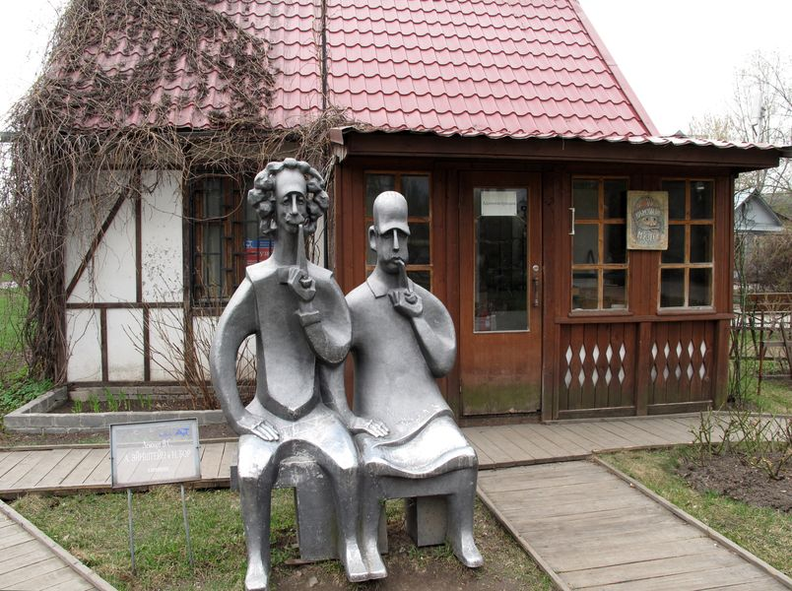
Learn from yesterday,
Live for today,
Hope for tomorrow!
The important thing is not to stop questioning.
- Albert Einstein.

